Slide 1
Employee Attrition Problem
Vishnu Teja Kasi

Slide 2
Introduction
The data of the company X is provided. There are 2 sets of data which are “Existing employees” and “Employees who have left”
To determine the reasons for employees to leave the company, from which department employees are leaving and who are prone to leave the company in the future is determined by analyzing the given data and comparing the attributes given in the data.
Visualizations are used to find out the reasons why employees are leaving and Analysis is used to determine the future trend of employees to leave the company

Slide 3
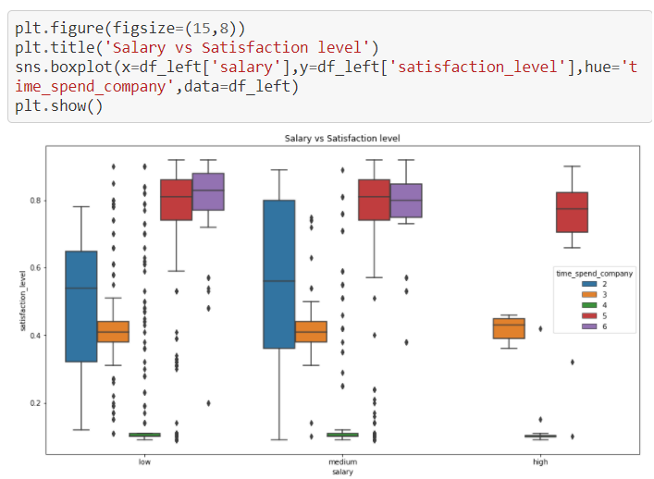
Salary VS Satisfaction level
Satisfaction level is very low for employees who spent time in the company equal to 4 for all levels of salary.
For low salary employees, most of the employees belong to the 2nd quartile with less satisfaction levels as we can see the median is shifted to the upper quartile.
We can see there are so many outliers from each salary levels.
The box plot is bigger for medium salary employees who spent time in the company is equal to 2, 50% of these employees have low satisfaction levels.
Input code and output Graph is shown above.

Slide 4
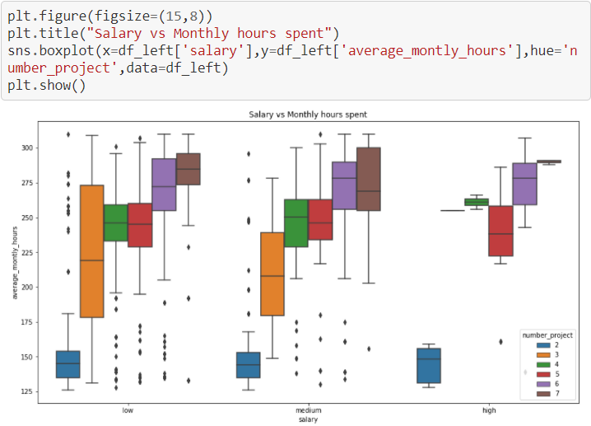
Salary vs Monthly hours spent
Average monthly hours is very low for employees who has number of projects equal to 2 for all levels of salary.
As we can see from the plot the employees from all levels for salary are loaded with projects and monthly hours is high.
We can see there are so many outliers from low and medium salary levels.
The box plot is bigger for low salary employees who has number of projects equal to 3, 50% of these employees high monthly hours.
Input and Output is shown above Employees are leaving because of higher number of projects and monthly hours spent

Slide 5
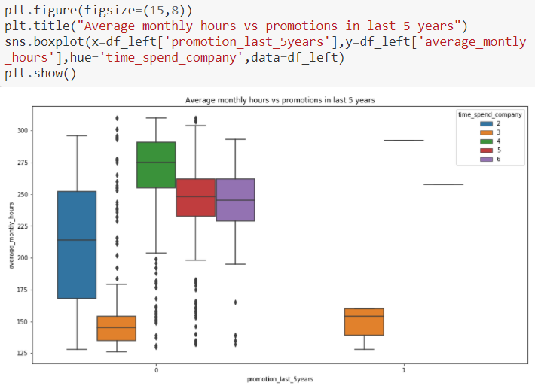
Average monthly hours vs promotion
Employees who got promotion in last 5 years have less average monthly hours, that to who has spend exactly 3 years in the company.
Very few employees from higher duration time spend in the company got promotion.
The employees who has not got the promotion are having higher average monthly hours and mostly time spend in the company is more than or equal 4 years with few outliers.

Slide 6
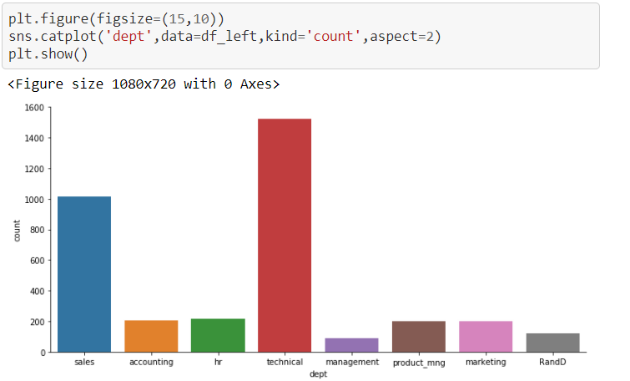
Distribution of employees leaving the department
Most of the employees leaving the company belongs to Sales and Technical departments

Slide 7
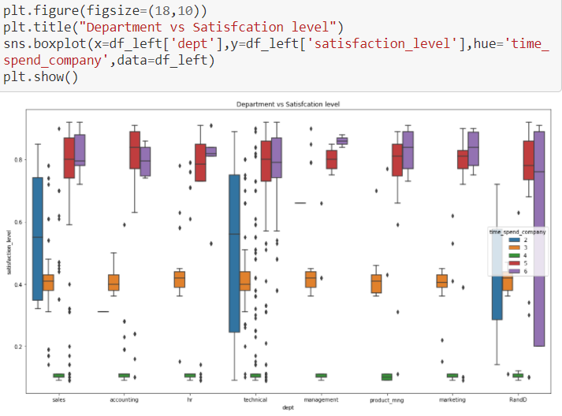
Department vs Satisfaction level
Employees from R&D department having 6 years of time spend having large distribution of satisfaction levels.
Time spend equal to 4 in all departments are having same level of very low satisfaction levels same goes for time spend equals to 3 having same level of average satisfactions in all departments.
Employees from sales and Technical department of 2 years of time spend is also having larger distributions of satisfaction levels as expected. Time spent in the company from 2-4 years are not satisfied, Specially the employees with 4 years of time spend, they are having least satisfaction than others from every departments

Slide 8
Reasons why Employees are leaving
Satisfaction level : 34.77%
Time spend in the company : 28.24%
Average monthly hours : 12.05%
Latest Evaluation : 11.46%
Number of projects : 10.77
Employees who are stressed up working more hours and having higher number of projects.
Overall, sales and technical department employees are leaving the company.
Employees are not getting promotion even they are working tirelessly and some many years

Slide 9
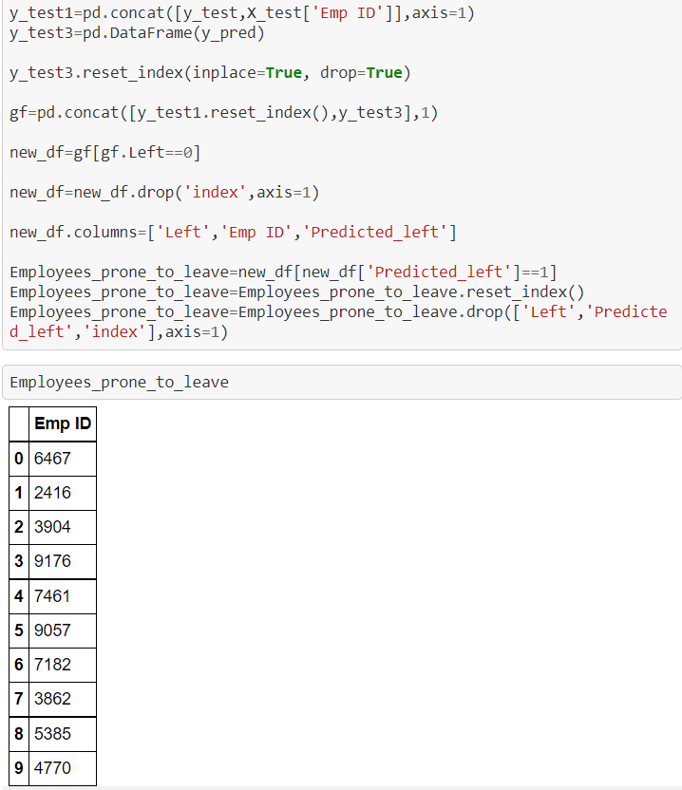
Employees Prone to leave in the future
The following are the employees who are prone to leave in the future. Employee ID of the employees has been provided for reference.

